Slide 1

Understanding Productivity and Turnover in Remote Teams
SDM Group A: Sam, Robert, Chelsea

Slide 2
Dataset Overview
Generated dataset with 400 observations
19 numerical variables
2 categorical variables
Variables capture work habits, performance metrics, and demographic info.

Slide 3
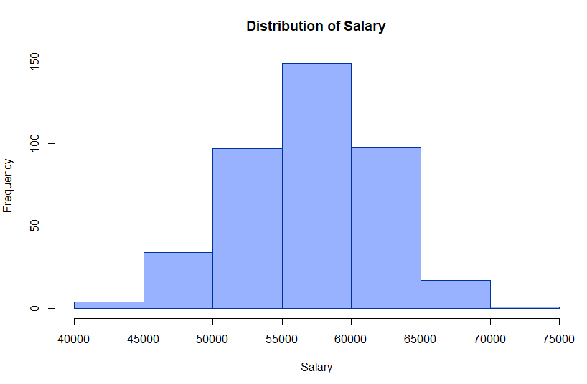
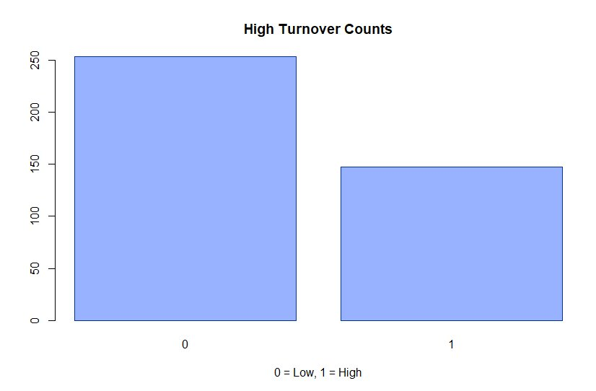
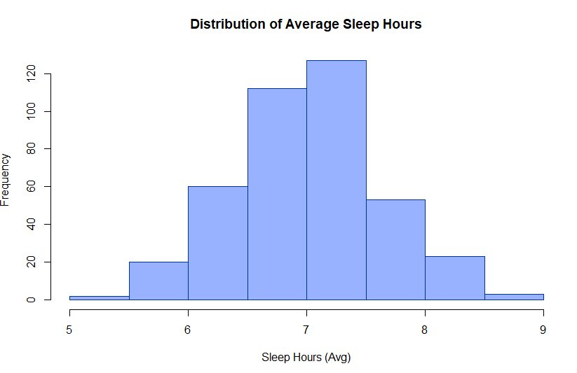
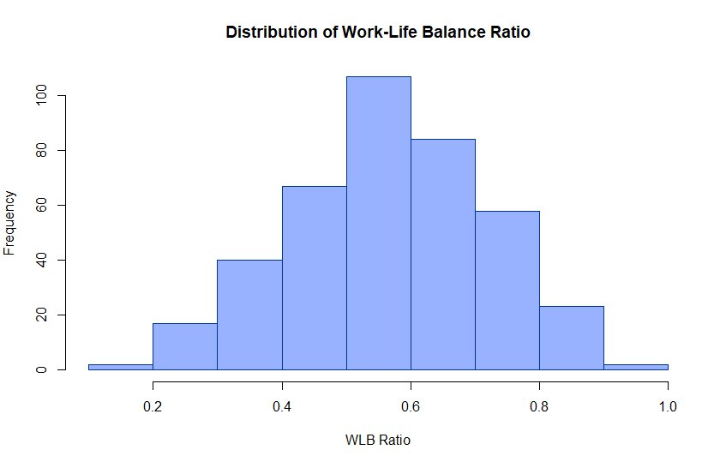
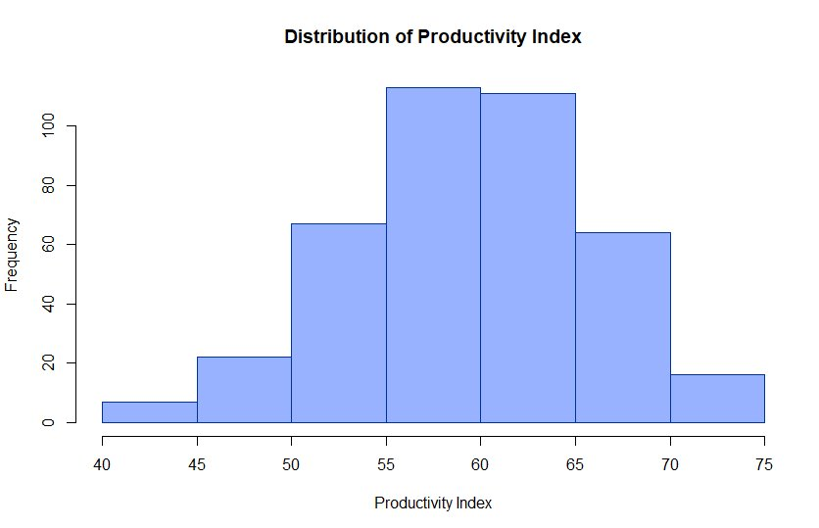
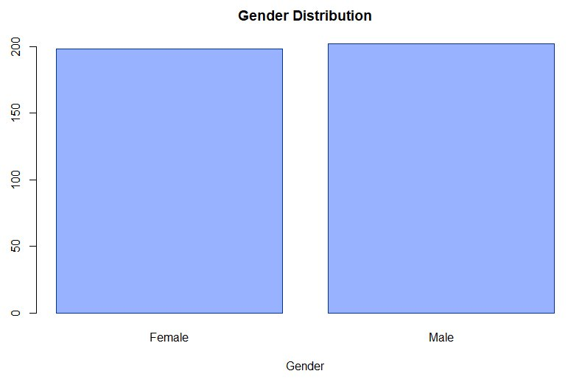
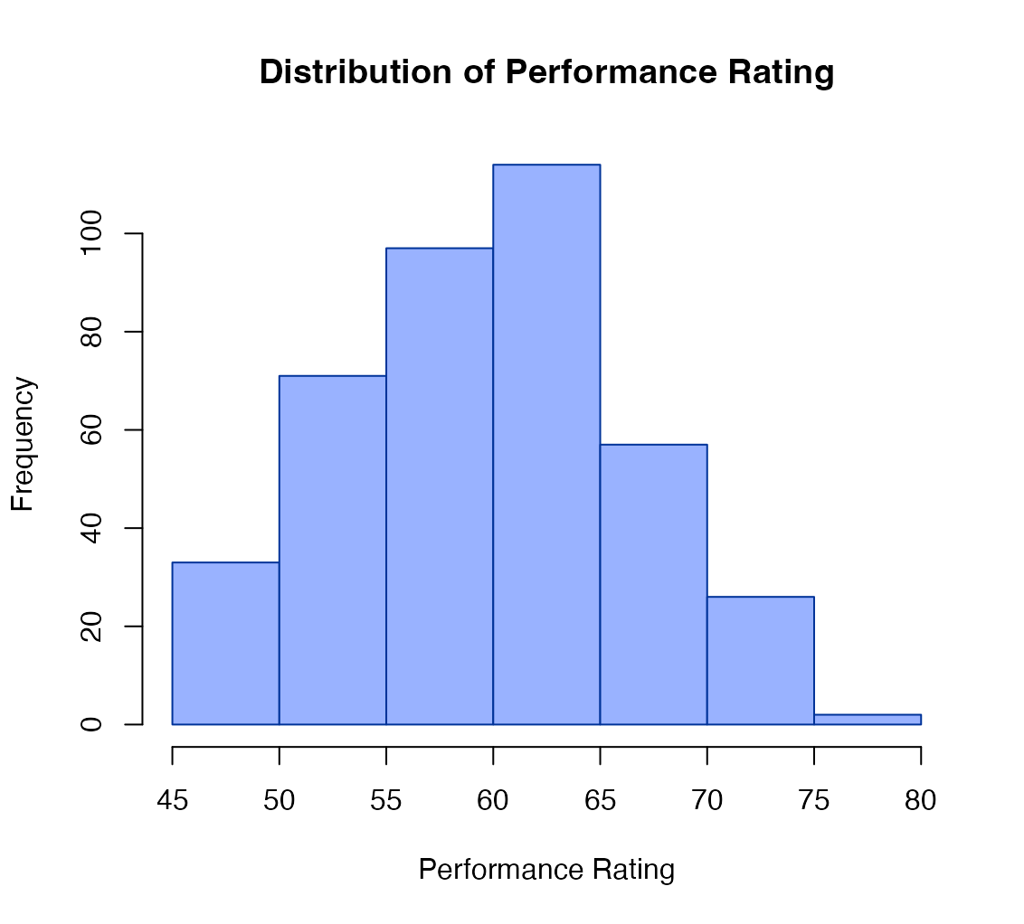
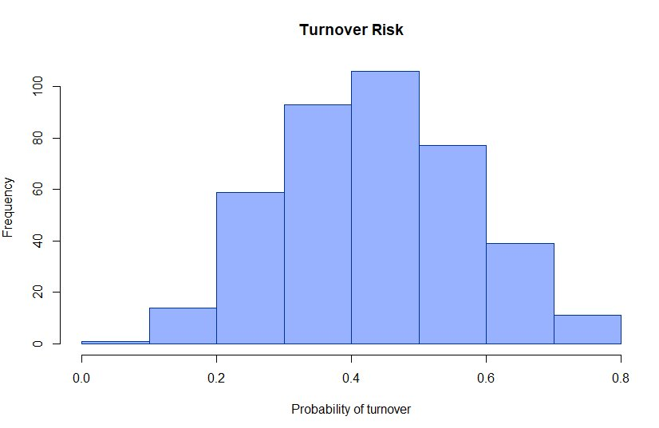


Distribution of Modeling Variables

Slide 4

Project Goals
Find if chosen variables are good predictors of our outcome variables: productivity and turnover rate using several different models
Does added complexity improve models?
What models perform the best?
What results are statistically significant?

Slide 5
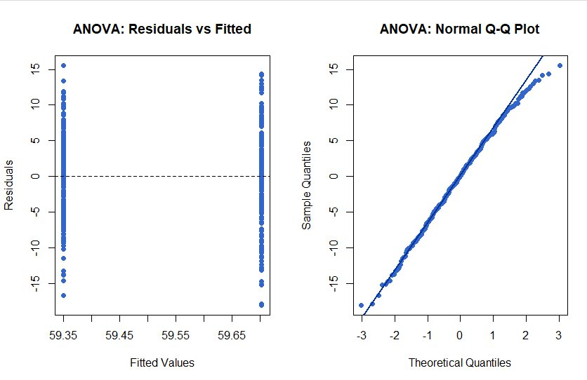

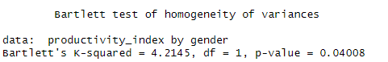
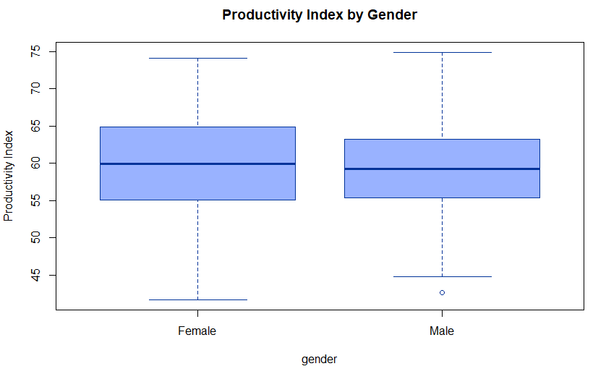

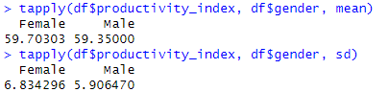
One-Way ANOVA: Productivity by Gender (½)
“Does gender influence productivity?”
Gender evenly distributed between males and females and productivity index normally distributed
Males and females have almost the same productivity scores and variability in the scores is about the same across genders
Bartlett test shows that there is a slight difference in variance, but the p-value is 0.04 meaning that it does not significantly affect our ANOVA conclusions (assumption of equal variance is met)
Residuals vs Fitted plot shows equal variance (homoscedasticity)
QQ plot mostly linear meaning residuals are normally distributed
All assumptions about the data are met

Slide 6
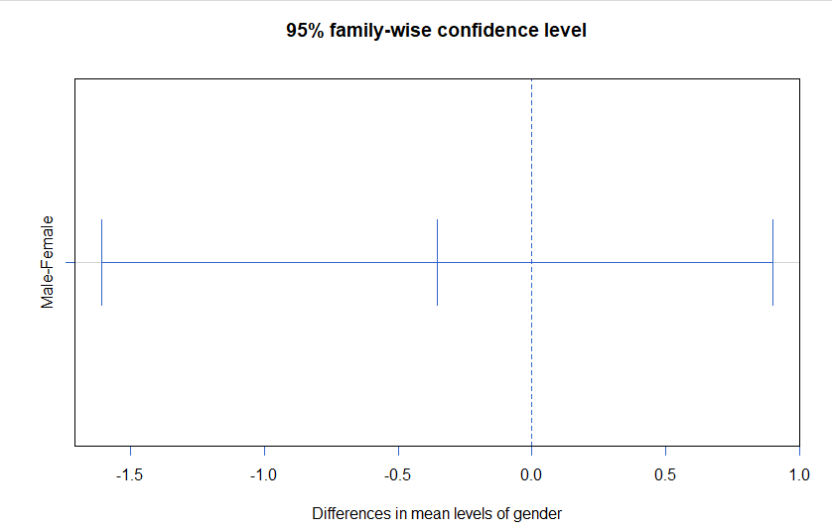
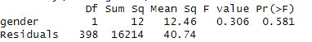
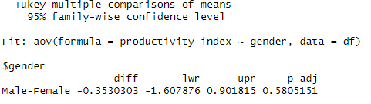
One-Way ANOVA: Productivity by Gender (2/2)
Summary statistics show p-value = 0.581 showing no statistically significant difference in productivity between genders
Tukey plot CI includes 0 and p-value is 0.58 both showing no statistical significance
Although the mean productivity score for males is 0.35 lower than females it is not a large enough difference to be considered significant
In conclusion gender has no significant effect on productivity index

Slide 7
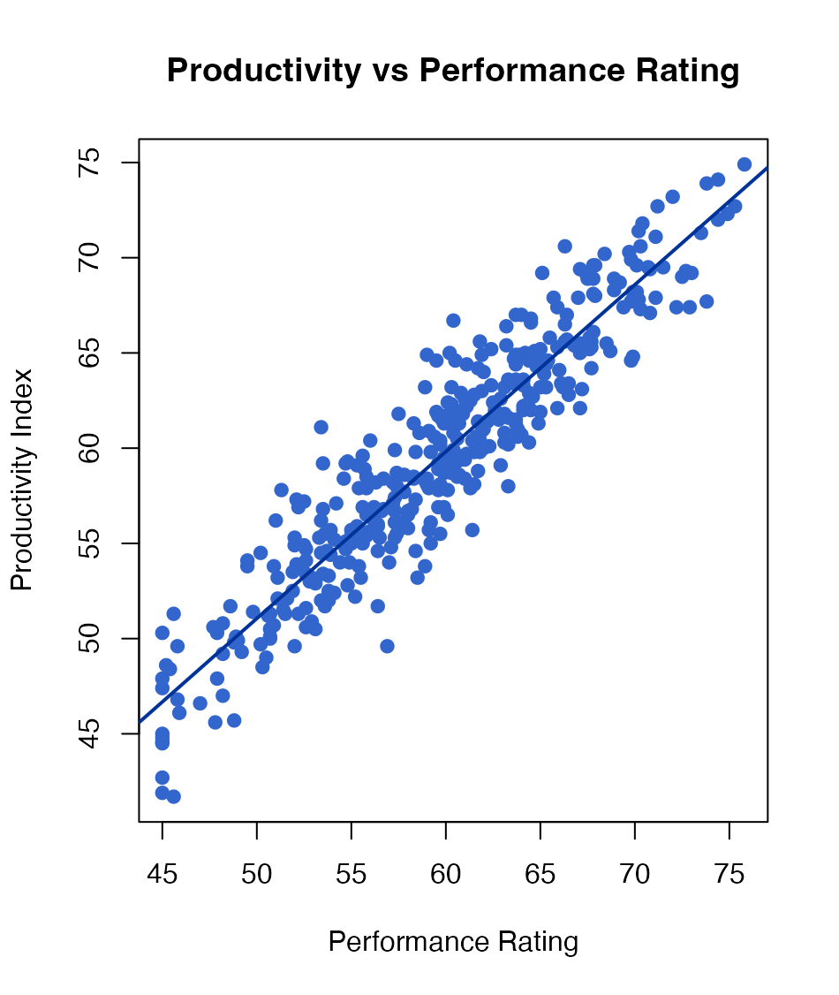
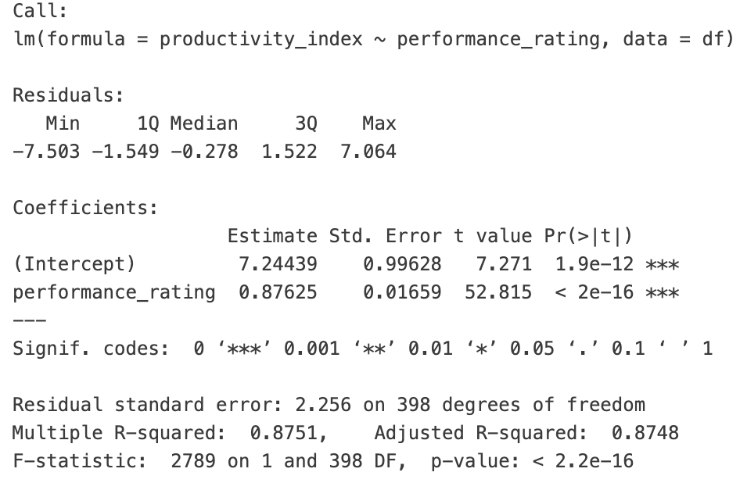



Simple Linear Regression (1/2)
Research question: "Do people who get better performance reviews have more professional output?"

Slide 8
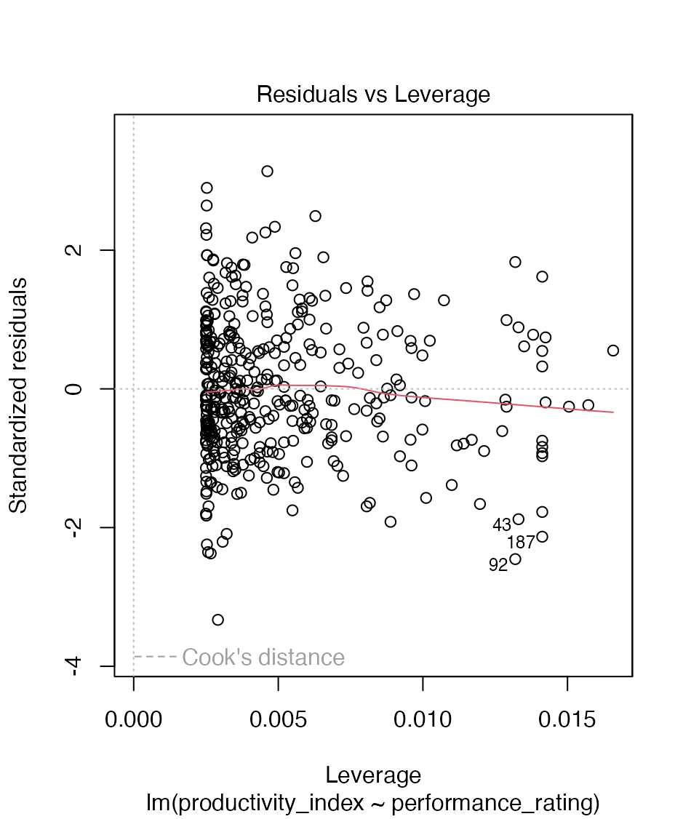
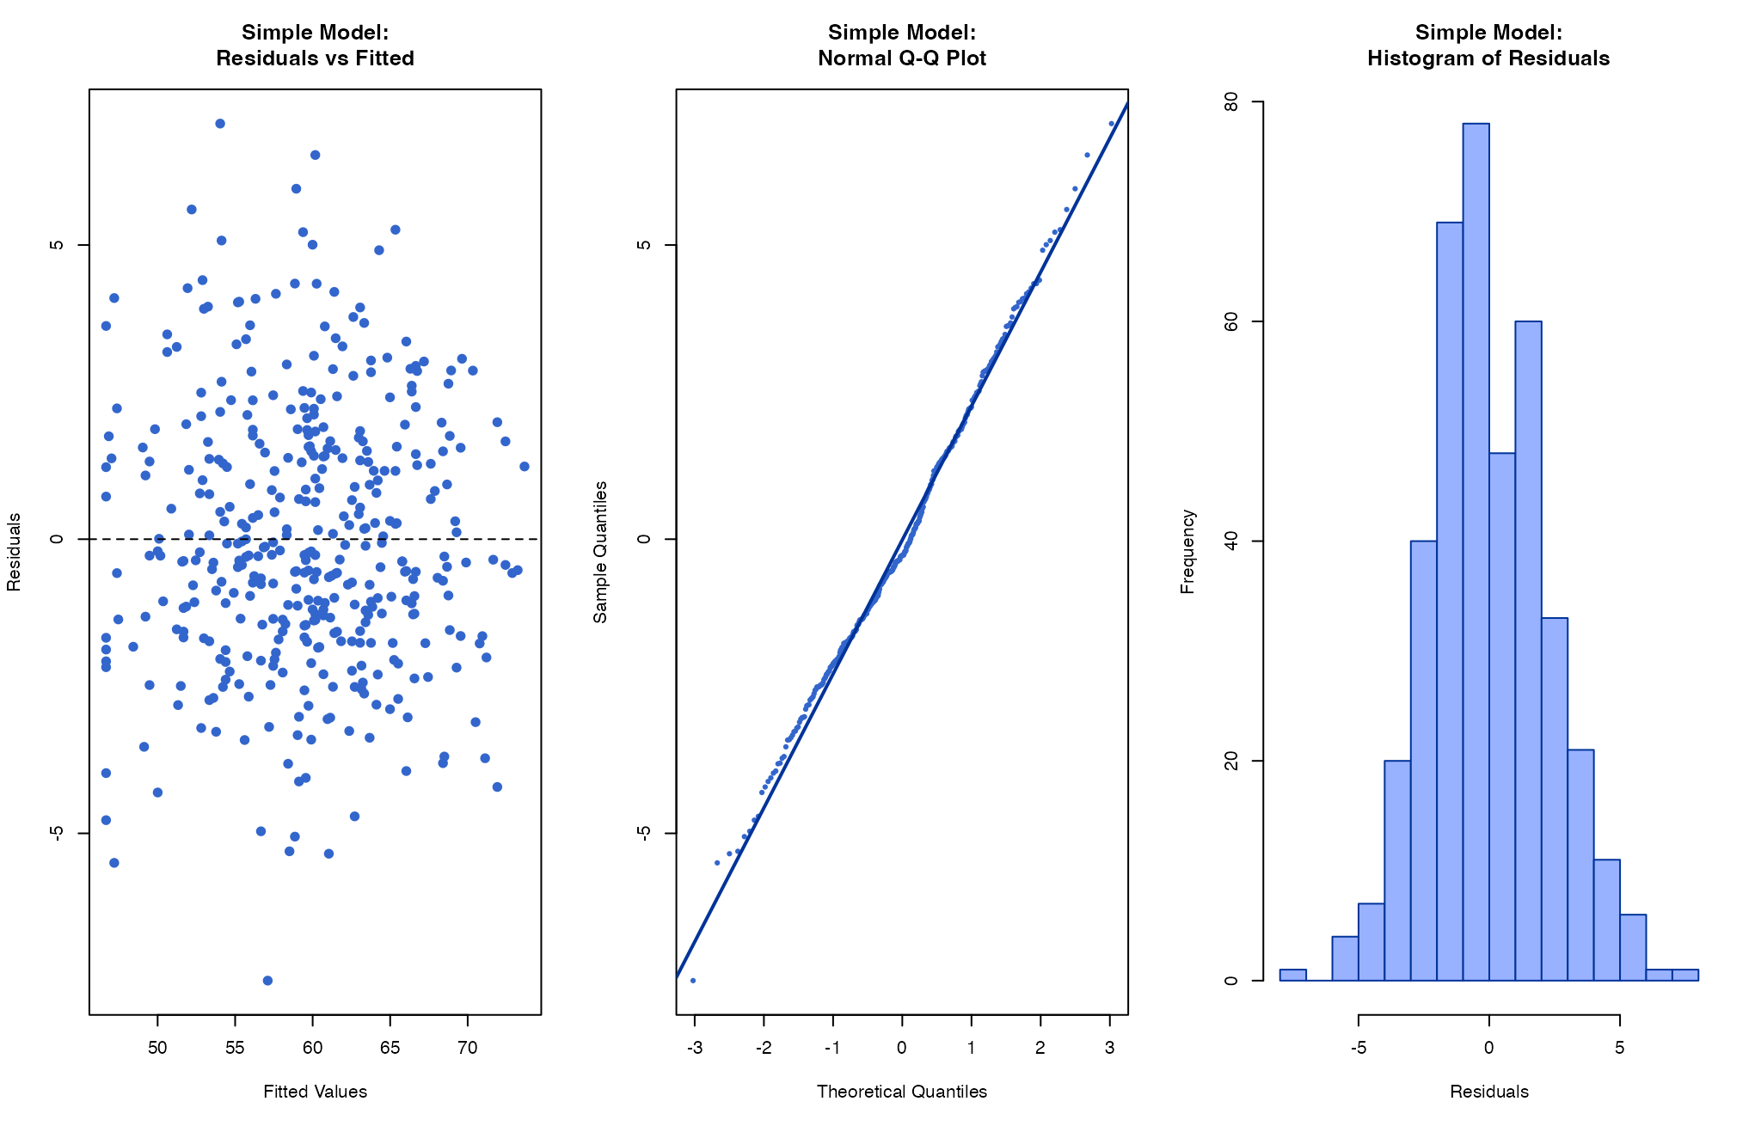
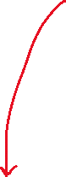
Simple Linear Regression (2/2)
**Passed Shapiro-wilk test!
Roughly flat!
Homoscedasticity/constant variance
“Which data points have unusually large influence on the regression model?”

Slide 9
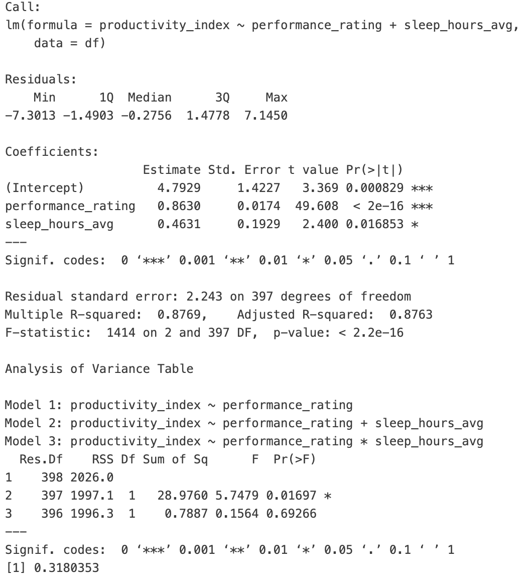
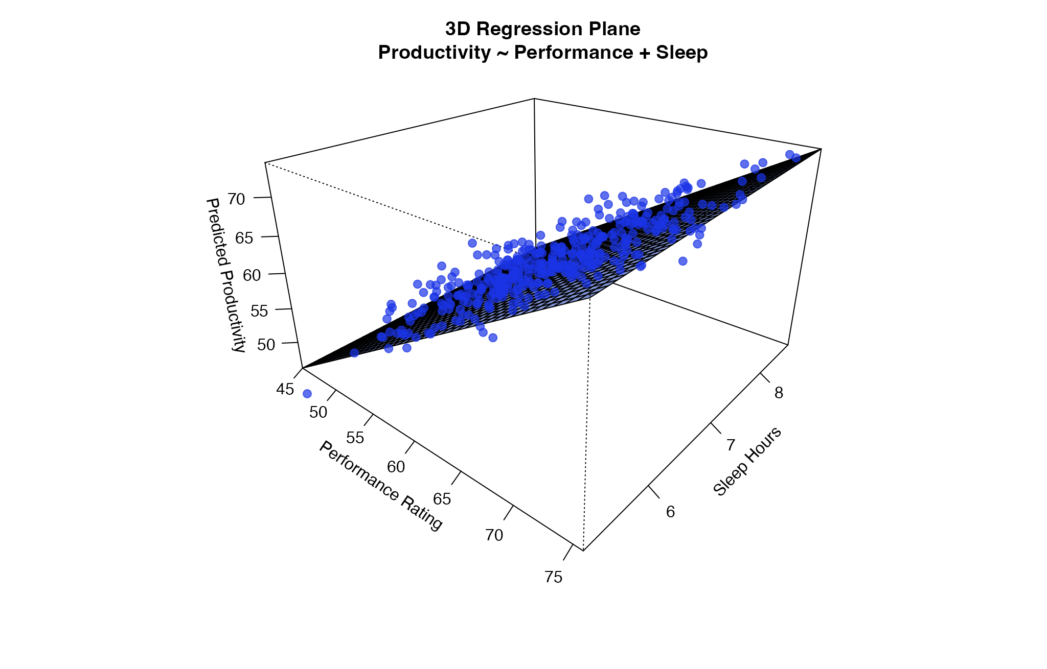








Multiple Linear Regression (1/2)
“Does sleep also impact productivity?”
* Not pictured: sleep_hours_avg is not significant in the full interaction model! Why?
Slight multicollinearity, interaction would amplify the effect

Slide 10
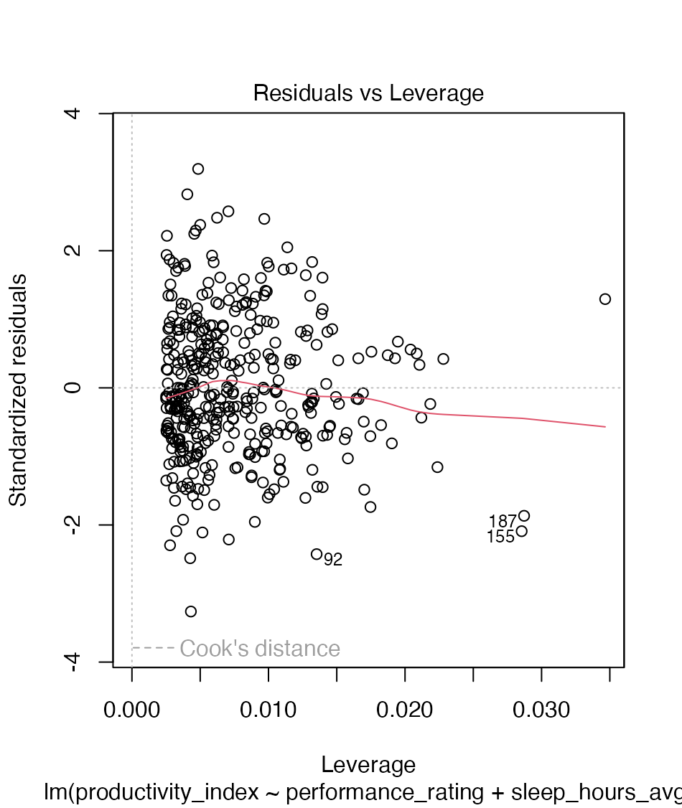
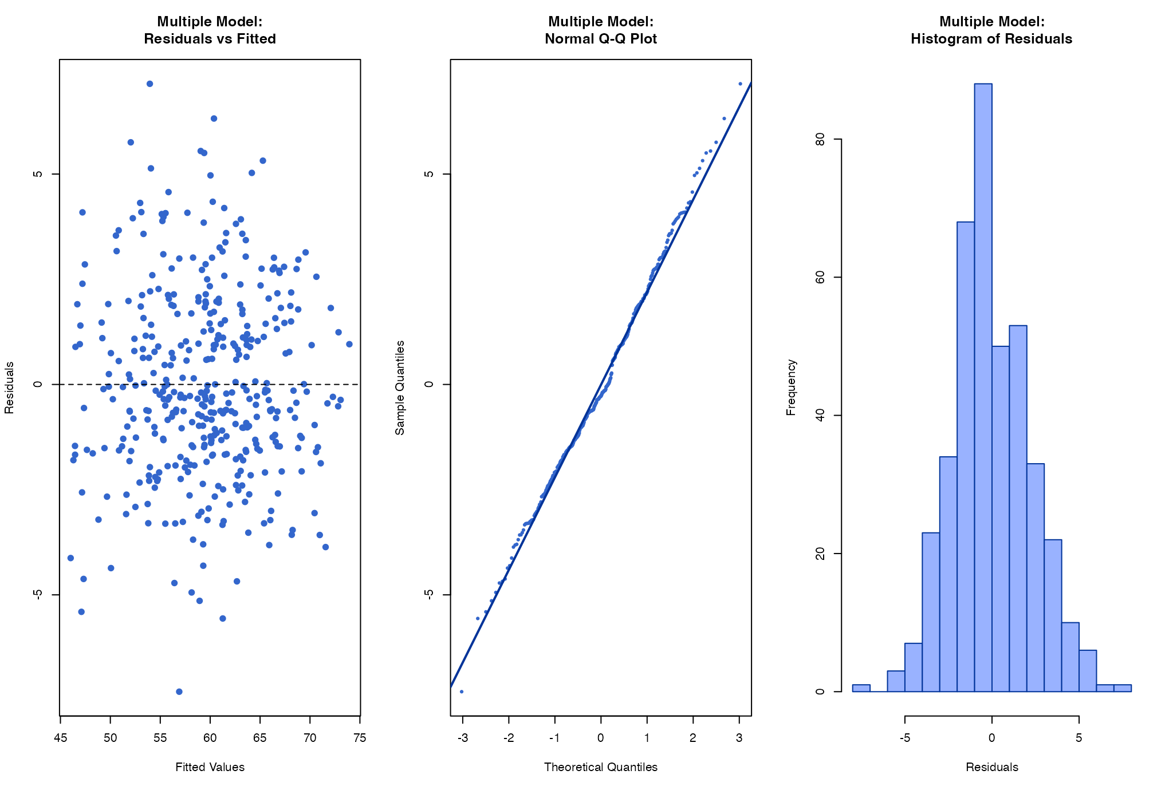
Multiple Linear Regression (2/2)
**Both pass Shapiro-wilk test
Constant variance again
Roughly horizontal line

Slide 11

Interpretation:
Productivity output has a strong positive linear relationship with performance rating and sleep hours. This relationship is statistically significant.
Adding sleep_hours_avg improves the simple model by helping to explain some additional variance in productivity.
Adding the interaction term does NOT help the model. It contributes essentially no improvement in predicting productivity.
These two predictors explain about 88% of the variation in productivity. The model is also statistically valid: linearity, normality, and independence (different people sampled) assumptions all hold.

Slide 12

Generalized Linear Model
Is the employee in a high turnover group?
Since the outcome of 'is_high_turnover' is 0 or 1, we used GLM
Two Main Predictors (Work Life Balance Ratio & Salary)

Slide 13
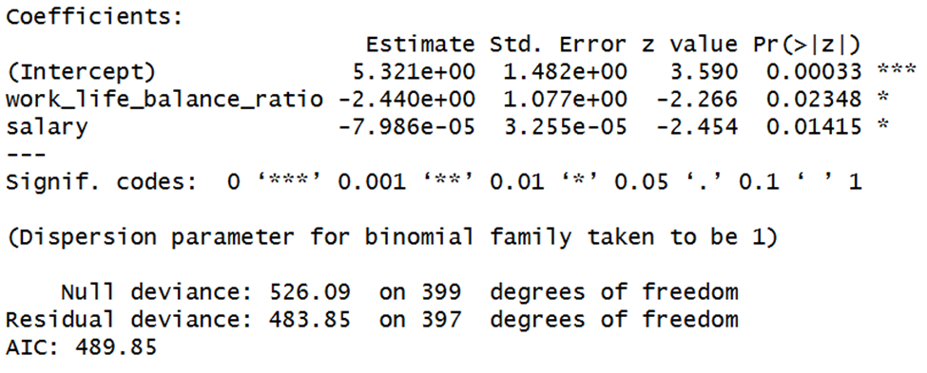
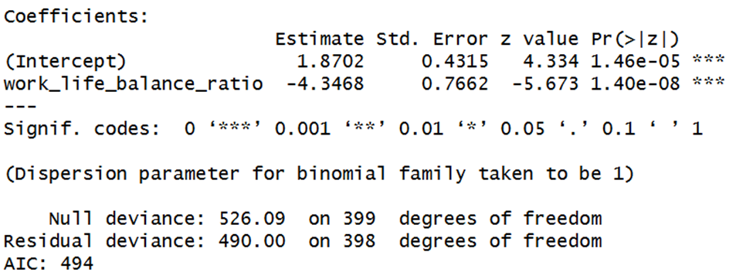
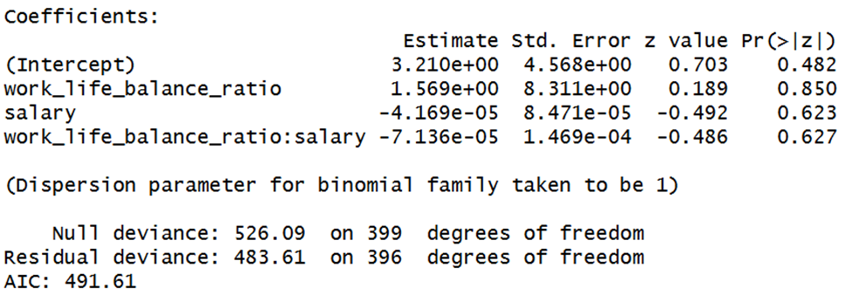
Logistic Models
Reduced Model: Uses Work Life Balance and Salary
Simple Model: Only considers Work Life Balance
Full Model: Uses Work Life Balance, Salary & its Interaction

Slide 14
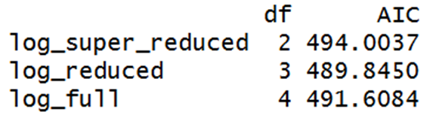
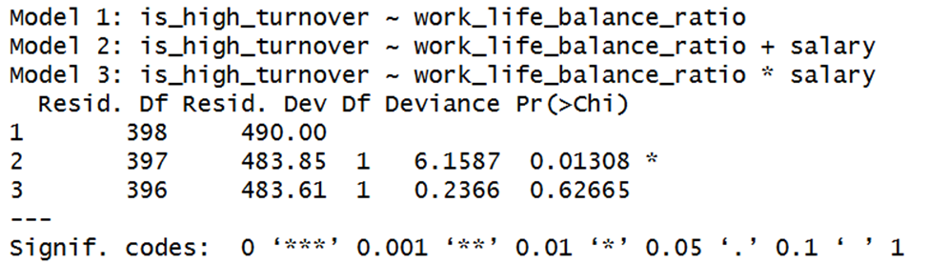
Comparison of Models
Deviance
Measure how wrong the model is overall
The lower the Deviance, the better the fit
Works with modeling probability.
AIC (Akaike Information Criterion)
Balances how well the model fits and how many extra predictors were used
The lower the AIC, the better the model
Likelihood Ratio Test
LRT looks at how much the fit improved when pieces are added
Chi-Squared
Big Chi-Squared & Small p-value = bigger model is better
Small Chi-Squared & large p-value = the bigger model isn't worth it.

Slide 15
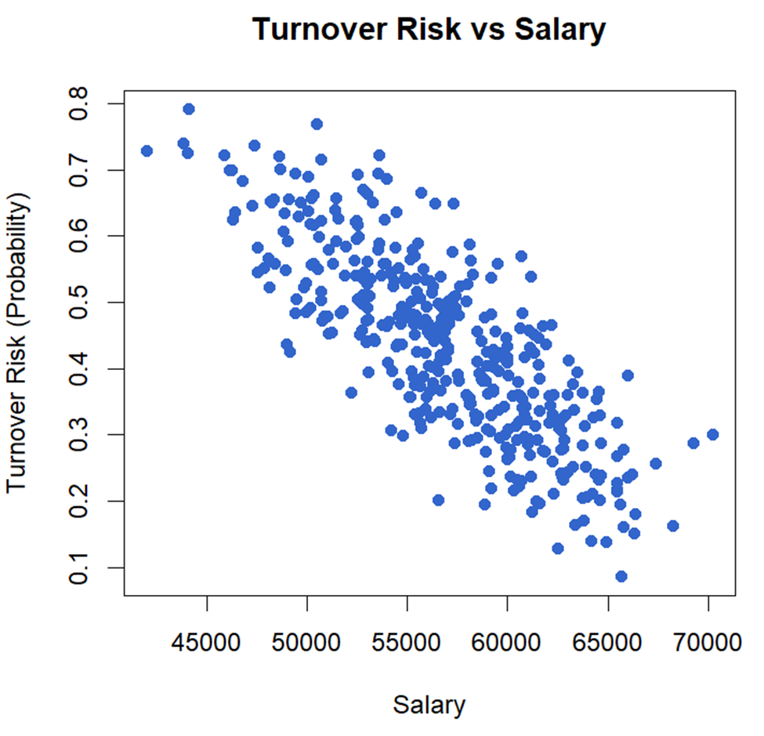
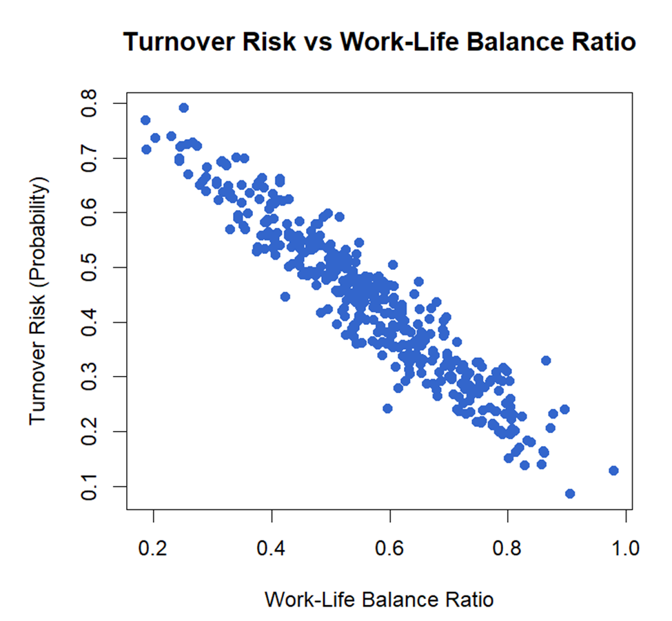
Graphics The following plots visualize the relationships we are inspecting)
Swaps WLB for Salary. Question being asked, do higher paid employees tend to have a lower turnover risk?
As Work-Life Balance get higher, turnover risk goes down

Slide 16
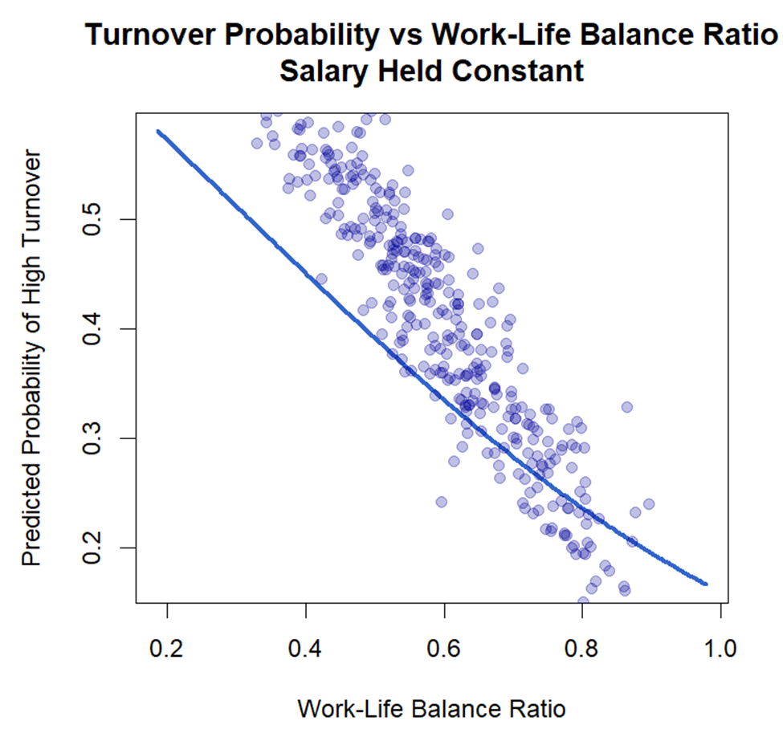
Graphics continued
 | The smooth line (curve) | Dots - the data points
What is it? | The model's prediction | Data points
Conclusion | Lower WLB = predicted probability of high turnover is better, | Lower WLB = higher observed turnover risk
 | As WLB rises, predicted probability falls sharply and then levels off | High WLB = lower observed turnover risk

Slide 17

Conclusions
Work Life Balance is a strong predictor
The better the WLB, the lower the chance of high turnover
Salary also significantly reduces turnover probability.
The interaction (WLB x Salary) was not useful.
The best model based on AIC and Deviance is the Reduced Model (WLB + Salary)

